Slide 1
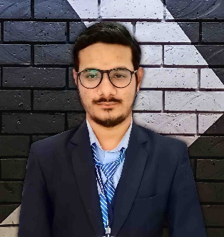








Nirbhay Hathaliya
DOB
Gender
Nationality
Marital status
30 / Aug / 1998
Male
Indian
Married
:
:
:
:
Laravel Developer
( Full Stack )
About me
Experienced Laravel Developer with over three years of hands-on experience in developing web applications I believe in smart work. I am self reliant and try to upgrade my self from time to time and also willing help others. I also like to do videos and photo editing. Skilled in programming languages and using them for web developing. I have both frontend as well as backend skills. I am kind hearted person. I keep myself calm in pressure situations.
Contact
Near by high school , Juthal - 362245
Dist – Junagadh
8200186326
hathaliyank@gmail.com
https://www.linkedin.com/in/nirbhay-hathaliya-3b9152156
Projects
College Projects
School management System ( C# ) , BCA
RTO Management System ( PHP ) , M.C.A - Sem - 3rd
RTO Management System ( Laravel ) , M.C.A - Sem - 6th
Farm Corner ( Django ) , M.C.A - Sem - 6th
Education
Internship Project
:
:
:
:
Premexo LLP
Science city road , The Capital , AA- 701 , Ahmedabad
4 Months
Qikchef Food Ordering web application , Technology : Laravel
Company
Address
Duration
Project
M.C.A.
S.P.I
Duration
-
-
10.00 S.P.I
2019 – 2021
B.C.A.
Percentage
Duration
Experience
-
-
78 %
2016 – 2019
PHP + Laravel Developer ( Duration - 2.6 Year )
:
:
:
:
Company
Joining Date
Leaving Date
Job Description
Teccel Software Pvt. Ltd. – Ahmedabad
August 2021
March 2024
Worked as Laravel developer, Team leader and also counselor.
Languages
Gujarati ( Mother tongue )
PHP + Laravel , Wordpress Developer
:
:
:
:
Hindi
Company
Joining Date
Leaving Date
Job Description
AtoZ CodingPvt. Ltd. – Ahmedabad
March 2024
Continue
Worked as Laravel and wordpress developer.
English
Hobbies
Skills
MVC Laravel
PHP
MySQL
Bootstrap 4 , 5
HTML
CSS
Javascript
Vue-js
Alpine-js
GitHub , Cpanel
Theme Integration
Wordpress
Coding
Teaching
Video & photo editing
Declaration
Music
I hereby declare that all the details furnished here are true to the best of my knowledge and belief.

